Slide 1
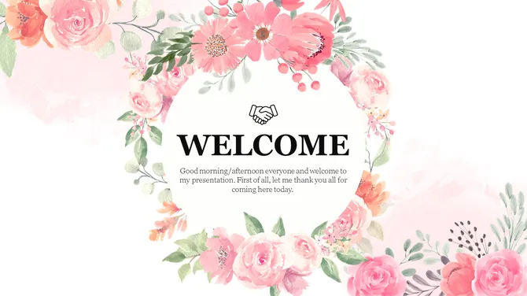
Title: Password Generator Tool
By Jatin Kumar

Slide 2
Project Description :
The Advanced Password Generator Tool is a Python-based desktop application built using Tkinter. It allows users to create strong and customizable passwords by specifying length, digits, special characters, and avoiding ambiguous characters. The app provides real-time password strength evaluation using a progress bar and saves generated passwords with timestamps to a CSV file. It includes features like clipboard copying, password history tracking, and a light/dark theme toggle for better user experience. Designed with security and usability in mind, this tool ensures users can generate secure passwords for various applications while maintaining a clean and interactive GUI environment.

Slide 3
Technologies & Tools:
Category | Technology/Tool | Purpose
Programming Language | Python | Core development of the application
GUI Library | Tkinter | Building the graphical user interface
Standard Library | random, string | Generating random passwords
Standard Library | datetime | Timestamping passwords when saving
Standard Library | csv | Saving generated passwords to a CSV file
External Library | pyperclip | Copying password to clipboard
GUI Widgets | Entry, Button, Label, Checkbutton | User input and interaction elements
GUI Widgets | Listbox, Progressbar (ttk) | Displaying password history and strength level
Styling | ttk.Style() | Customizing progress bar appearance
File Handling | CSV File | Storing password logs locally
Theme Feature | Light/Dark Mode Toggle | Enhancing user experience

Slide 4
Challenges Faced:
Challenge Area | Description
Password Strength Logic | Designing a reliable and intuitive algorithm to evaluate password strength.
Ambiguous Characters | Implementing logic to exclude visually similar characters (e.g., i, 1, l, 0, O).
Theme Toggle | Dynamically updating widget styles and colors for light/dark themes.
Clipboard Access | Ensuring cross-platform compatibility for copying passwords using pyperclip.
CSV File Handling | Preventing data overwrite and managing proper timestamped entries.
GUI Layout Management | Organizing widgets cleanly while keeping the interface responsive and usable.
Error Handling | Validating user input (e.g., numeric length) and managing incorrect inputs.

Slide 5

Project Approach :
First, we identified the need for a secure and user-friendly password generator.
Designed the user interface using Tkinter to make it simple and clean.
Implemented the main password generation logic with options for digits, special characters, and length.
Added a password strength checker to guide users about how strong their password is.
Included extra features like copying to clipboard, saving to a CSV file, and viewing password history.
Added a light/dark theme switch to improve user experience.
Finally, tested all functions and fixed any errors to make it work smoothly.

Slide 6
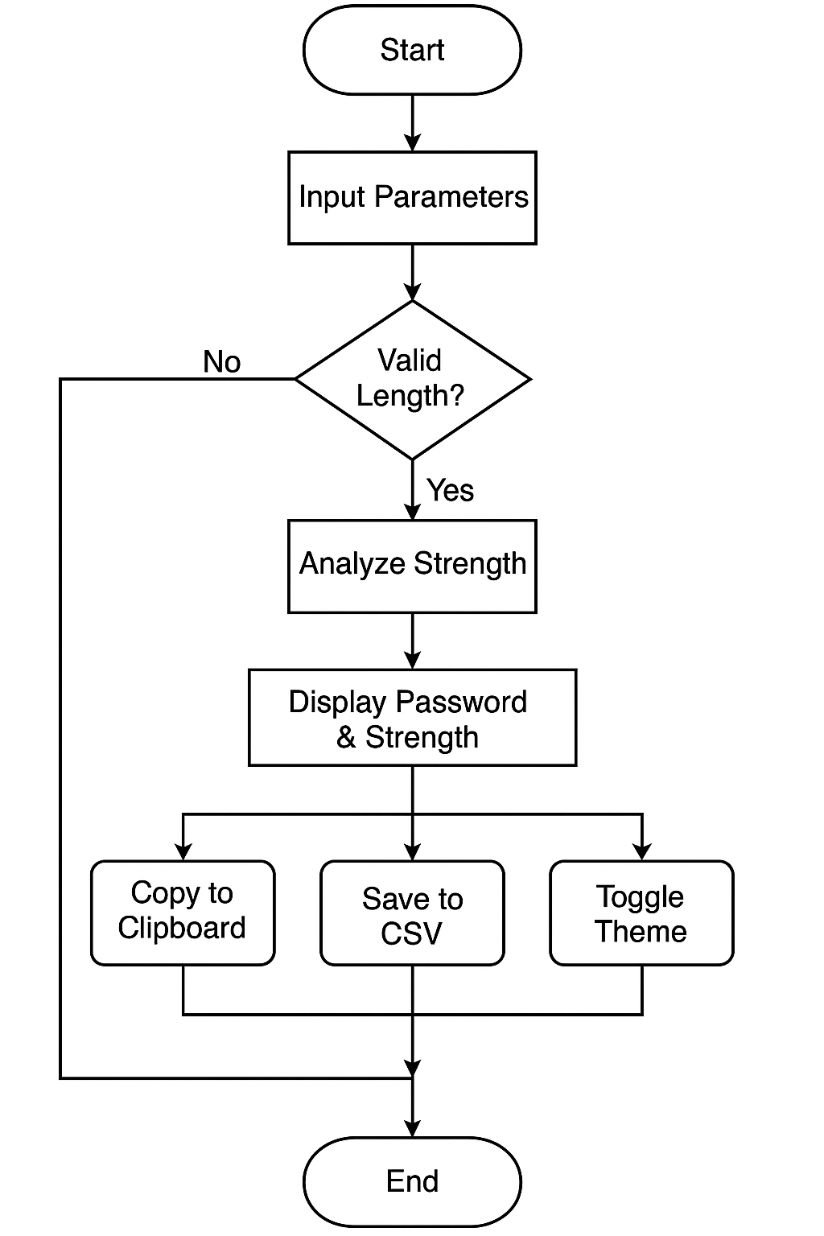
FLOWCHART:

Slide 7
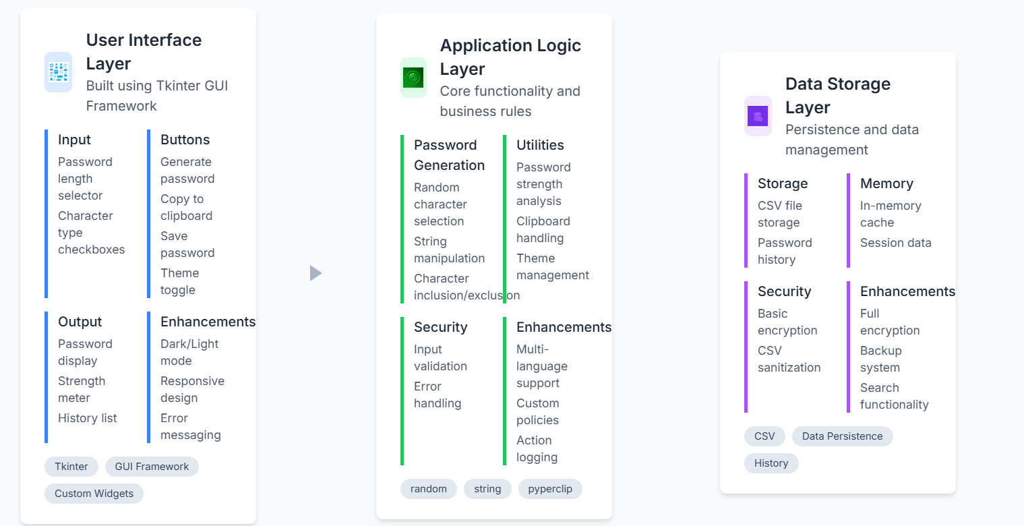
FLOW CONTROL:

Slide 8
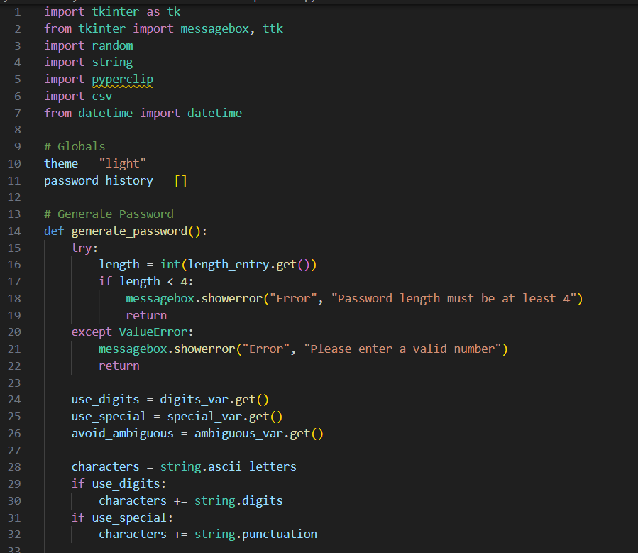
Code:

Slide 9
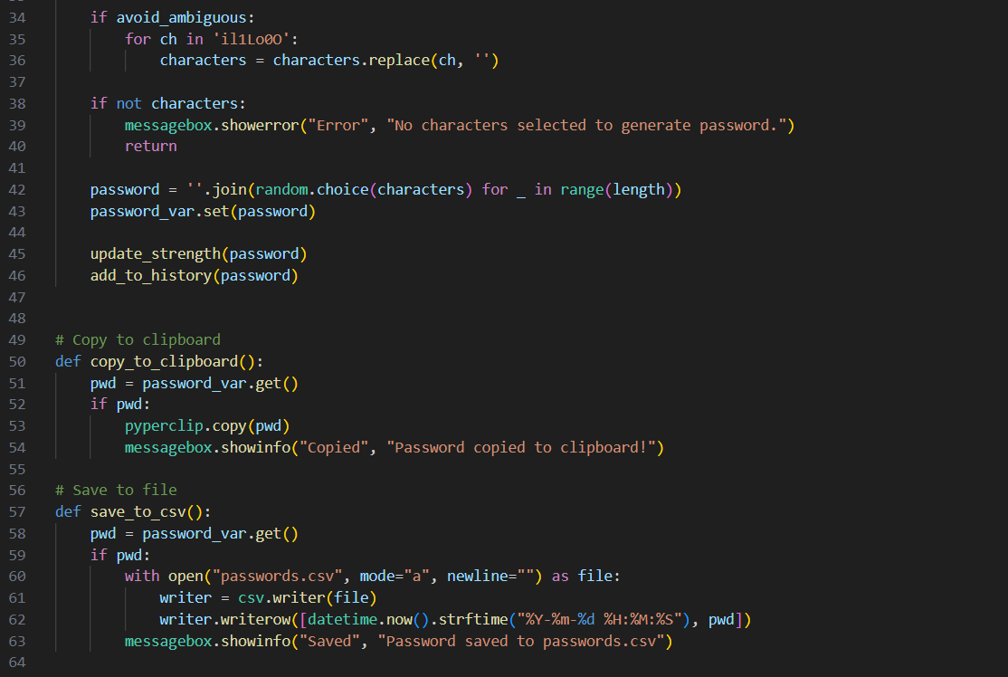

Slide 10
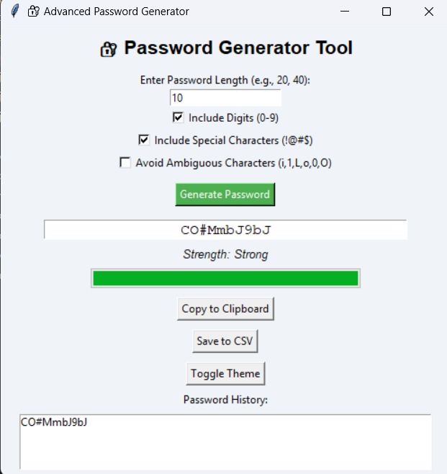
Final output :

Slide 11
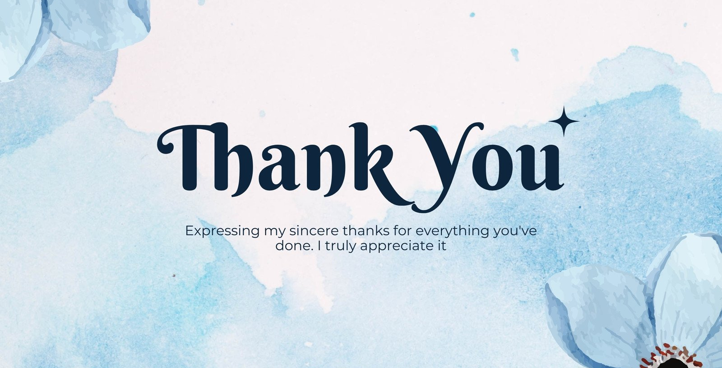
Project Title : Smart To-Do List Manager with Reminders and Email Alerts
SUBMITTED BY: JATIN KUMAR
SUBMITTED TO TAMIZHAN SKILLS

